Slide 1
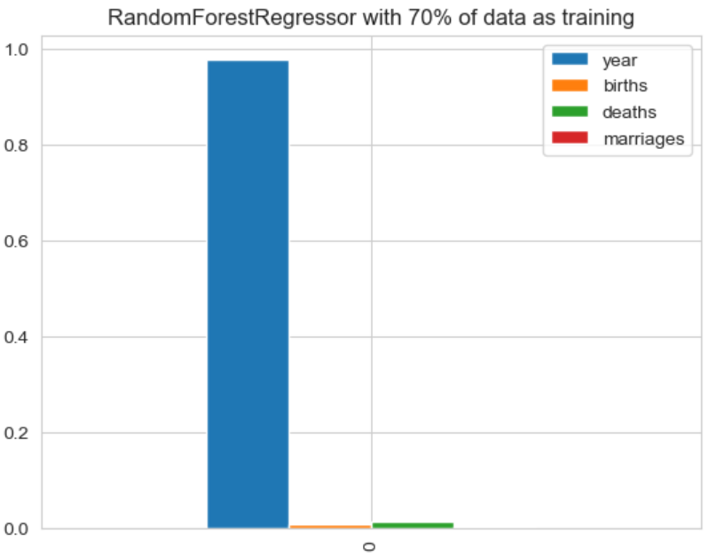
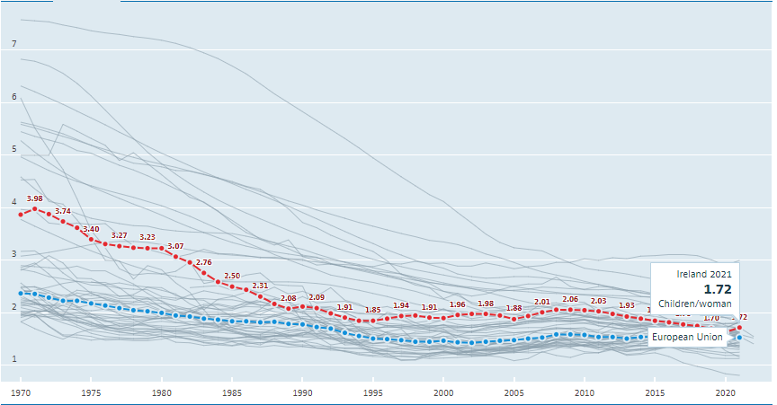
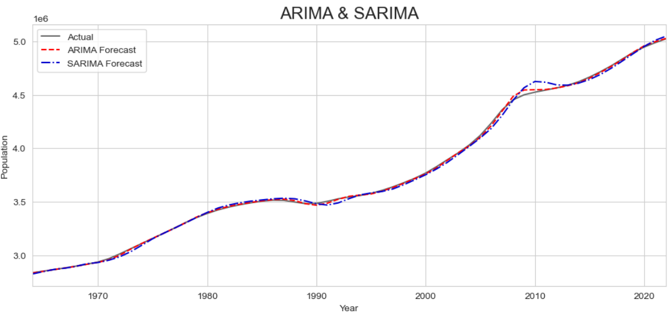
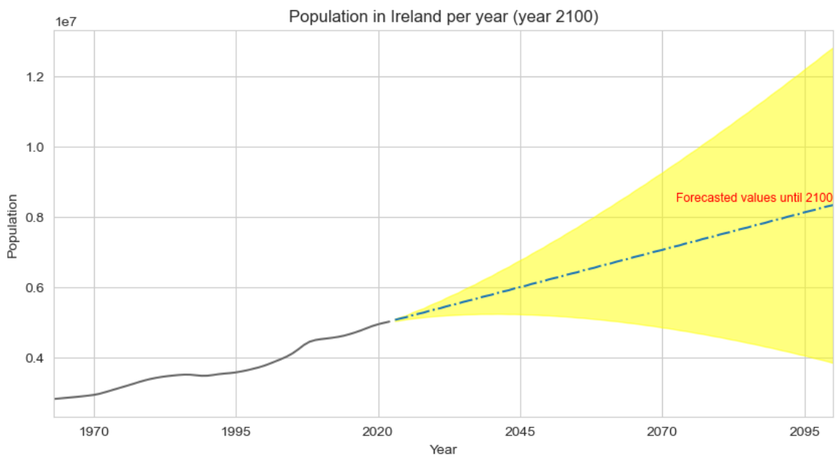
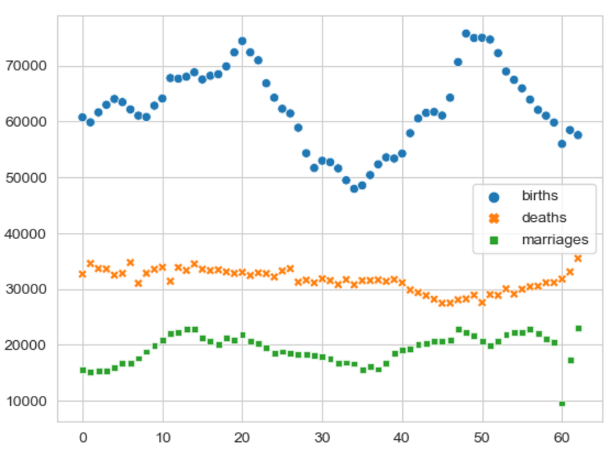
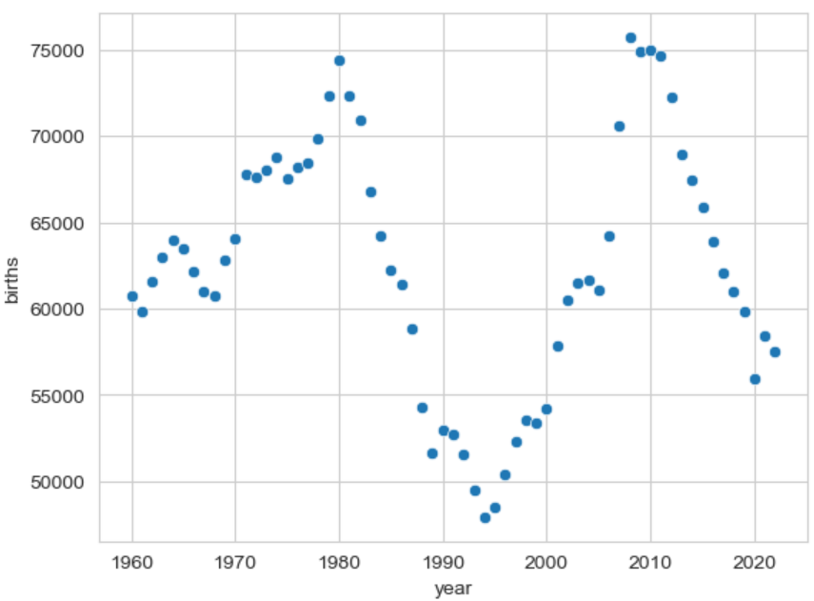
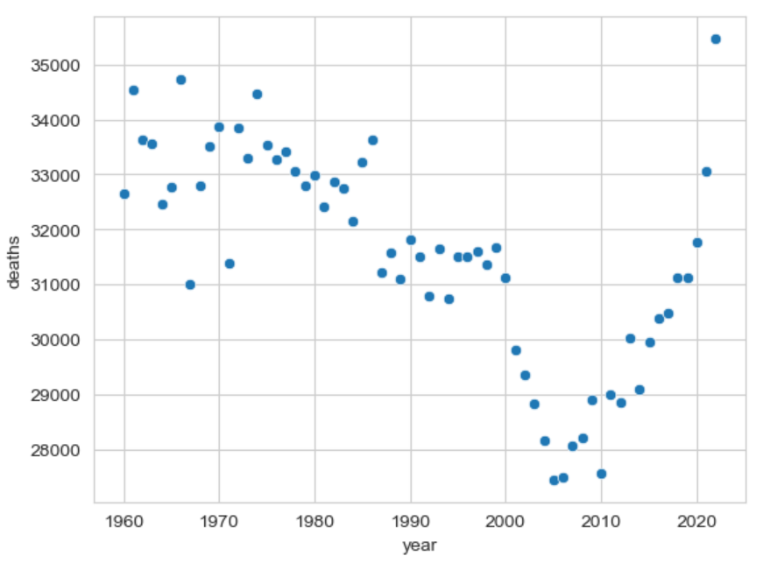
Population in Ireland: Where are we heading to?
Leopoldo Rojo Romero, CCT College Dublin, May 2024
Introduction
Findings
Human resource is an important subject of any stable economy, a large population means more workers and customers, which ultimately boosts a country’s GDP (World101, 2022).
The Organisation for Economic Co-operation and Development (OECD), stated that a country requires a birth rate of 2.1 children per woman to maintain a healthy population growth. However, as shown in the following figure, Ireland has recorded a progressive decline in its birth rate since 1970 (OECD, 2023).
From our Random Forest Regressor model, we can observe that there is a predominantly feature, which is time, our ‘year’ feature in this case as shown in the following figure.
As shown in the figure below, when we perform a forecast from our ARIMA and SARIMA models, we can tell that our ARIMA model performs slightly better than our SARIMA model, nonetheless, we already know that seasonality its being created with declining births in Ireland every 15 years, therefore, we will use our SARIMA model to forecast the population in Ireland until the year 2100.
Objectives
Observe through exploratory analysis of our data, the population growth/decline trend in Ireland from 1960 to 2022.
Check for correlation between the number of births, deaths and marriages, been determining factors of population growth or decline in Ireland.
Find an optimal machine learning model that makes projections into the future regarding Ireland’s population.
Analyse our results to make conclusions concerning Ireland’s population stability.
Machine Learning models
Random Forest Regressor, this model will help us understand which is the determining factor regarding population.
ARIMA, Autoregressive Integrated Moving Average, takes into account the past values and predicts future values based on that (Bajaj, 2023).
SARIMA, Seasonal – ARIMA, similarly to ARIMA, uses past values but also takes into account any seasonality patterns (Bajaj, 2023).
Findings
If we observe the relationship between births, deaths and marriages, we can notice that marriages have remained stable throughout the years, however, we can see a clear pattern of declining births in Ireland every 15 years and a declining pattern of population deaths from 1970 to 2005, nevertheless, since then, Ireland’s population deaths has been dramatically rising.
Conclusions
Ireland’s population stability: The results of this analysis suggest that Ireland have and will have a stable population growth in the coming years, however, we cannot leave out the fact that there is a pattern of declining births every 15 years as the data showed us, following this pattern, by the year 2025 we can expect a new record low in births per year.
Note that in this analysis, immigration was not taken into account, which is an important factor for Ireland’s population growth, as stated by the Central Statistics Office, population change closely coincides with the trend in net migration (Central Statistics Office, 2023).
References
Bajaj, A. (2023). ARIMA & SARIMA: Real-World Time Series Forecasting. [online] neptune.ai. Available at: https://neptune.ai/blog/arima-sarima-real-world-time-series-forecasting-guide.
Central Statistics Office (2023). Key Findings - CSO - Central Statistics Office. [online] www.cso.ie. Available at: https://www.cso.ie/en/releasesandpublications/ep/p-pme/populationandmigrationestimatesapril2023/keyfindings/.
World101 from The Council on Foreign Relations (2022). Global Population Growth Is Slowing Down. [online] World101 from the Council on Foreign Relations. Available at: https://world101.cfr.org/global-era-issues/development/global-population-growth-slowing-down#:~:text=Studies%20differ%20about%20the%20exact [Accessed 24 Oct. 2023].
Organisation for Economic Co-operation and Development (2023). Fertility rates - OECD data. [online] OECD. Available at: https://data.oecd.org/pop/fertility-rates.htm [Accessed 13 Oct. 2023].

